Slide 1
Chapter 4
Basic SQL

Slide 2
Chapter 4 Outline
SQL Data Definition and Data Types
Specifying Constraints in SQL
Basic Retrieval Queries in SQL
INSERT, DELETE, and UPDATE Statements in SQL
Additional Features of SQL

Slide 3
Basic SQL
SQL language
  Considered one of the major reasons for the commercial success of relational databases
SQL
  Structured Query Language
  Statements for data definitions, queries, and updates (both DDL and DML)
  Core specification
  Plus specialized extensions

Slide 4
SQL Data Definition and Data Types
Terminology:
  Table, row, and column used for relational model terms relation, tuple, and attribute
CREATE statement
  Main SQL command for data definition

Slide 5
Schema and Catalog Concepts in SQL
SQL schema
  Identified by a schema name
  Includes an authorization identifier and descriptors for each element
Schema elements include
  Tables, constraints, views, domains, and other constructs
Each statement in SQL ends with a semicolon

Slide 6
Schema and Catalog Concepts in SQL (cont’d.)
CREATE SCHEMA statement
  CREATE SCHEMA COMPANY AUTHORIZATION ‘Jsmith’;
Catalog
  Named collection of schemas in an SQL environment
SQL environment
  Installation of an SQL-compliant RDBMS on a computer system

Slide 7
The CREATE TABLE Command in SQL
Specify a new relation
  Provide name
  Specify attributes and initial constraints
Can optionally specify schema:
  CREATE TABLE COMPANY.EMPLOYEE ...
  or
  CREATE TABLE EMPLOYEE ...

Slide 8
The CREATE TABLE Command in SQL (cont’d.)
Base tables (base relations)
  Relation and its tuples are actually created and stored as a file by the DBMS
Virtual relations
  Created through the CREATE VIEW statement

Slide 9
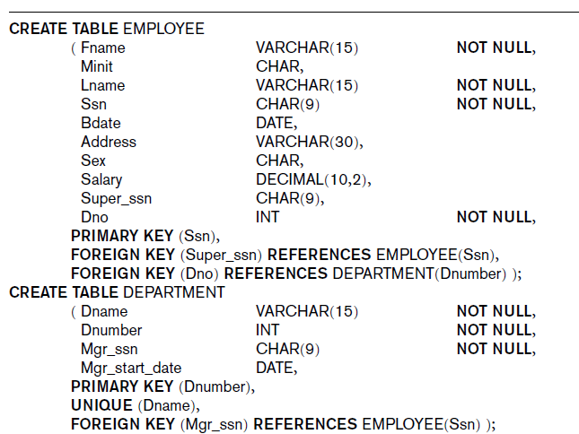
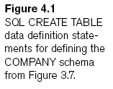
Notes:
SQL CREATE TABLE data definition statements for defining the COMPANY schema

Slide 10
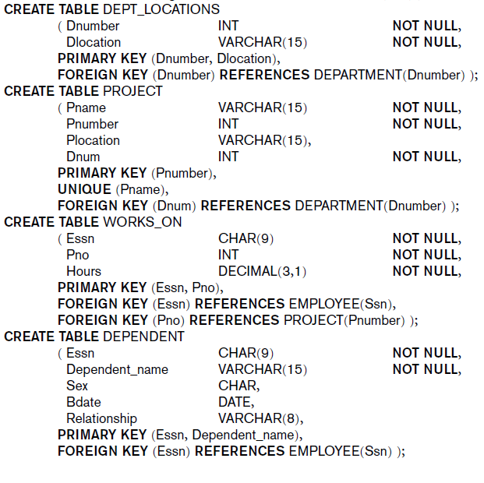
Notes:
A CHAR field is a fixed length, and VARCHAR is a variable length field.

Slide 11
The CREATE TABLE Command in SQL (cont’d.)
Some foreign keys may cause errors
  Specified either via:
    Circular references
    Or because they refer to a table that has not yet been created

Slide 12
Attribute Data Types and Domains in SQL
Basic data types
  Numeric data types
    Integer numbers: INTEGER, INT, and SMALLINT
    Floating-point (real) numbers: FLOAT or REAL, and DOUBLE PRECISION
  Character-string data types
    Fixed length: CHAR(n), CHARACTER(n)
    Varying length: VARCHAR(n), CHAR VARYING(n), CHARACTER VARYING(n)

Slide 13
Attribute Data Types and Domains in SQL (cont’d.)
  Bit-string data types
    Fixed length: BIT(n)
    Varying length: BIT VARYING(n)
  Boolean data type
    Values of TRUE or FALSE or NULL
  DATE data type
    Ten positions
    Components are YEAR, MONTH, and DAY in the form YYYY-MM-DD
Notes:
A bit string is a sequence of bits. Bit strings can be used to represent sets or to manipulate binary data

Slide 14
Attribute Data Types and Domains in SQL (cont’d.)
Additional data types
  Timestamp data type (TIMESTAMP)
    Includes the DATE and TIME fields
    Plus a minimum of six positions for decimal fractions of seconds
    Optional WITH TIME ZONE qualifier
  INTERVAL data type
    Specifies a relative value that can be used to increment or decrement an absolute value of a date, time, or timestamp
Notes:
INTERVAL data type : e. g. exact differences between datetimes
Or e. g. Number of minutes/seconds between two date/times.

Slide 15
Attribute Data Types and Domains in SQL (cont’d.)
Domain
  Name used with the attribute specification
  Makes it easier to change the data type for a domain that is used by numerous attributes
  Improves schema readability
  Example:
    CREATE DOMAIN SSN_TYPE AS CHAR(9);
Notes:
MySQL doesn't support user-defined domains, so it is not possible to run a CREATE DOMAIN statement on MySql.

Slide 16
Specifying Constraints in SQL
Basic constraints:
  Key and referential integrity constraints
  Restrictions on attribute domains and NULLs
  Constraints on individual tuples within a relation

Slide 17
Specifying Attribute Constraints and Attribute Defaults
NOT NULL
  NULL is not permitted for a particular attribute
Default value
  DEFAULT <value>
CHECK clause
  Dnumber INT NOT NULL CHECK (Dnumber > 0 AND Dnumber < 21);
Notes:
Unfortunately MySQL does not support SQL check constraints.
e.g. ALTER TABLE CUSTOMER ADD age INT NOT NULL DEFAULT 30 CHECK (age > 18 AND age < 90);
ALTER TABLE table_name
MODIFY COLUMN column_name datatype;

Slide 18
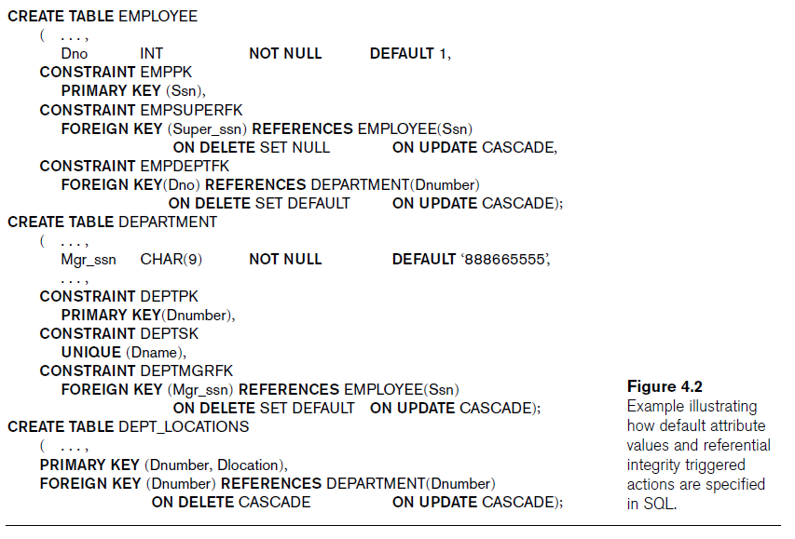

Slide 19
Specifying Key and Referential Integrity Constraints
PRIMARY KEY clause
  Specifies one or more attributes that make up the primary key of a relation
  Dnumber INT PRIMARY KEY;
UNIQUE clause
  Specifies alternate (secondary) keys
  Dname VARCHAR(15) UNIQUE;

Slide 20
Specifying Key and Referential Integrity Constraints (cont’d.)
FOREIGN KEY clause
  Default operation: reject update on violation
  Attach referential triggered action clause
    Options include SET NULL, CASCADE, and SET DEFAULT
    Action taken by the DBMS for SET NULL or SET DEFAULT is the same for both ON DELETE and ON UPDATE
    CASCADE option suitable for “relationship” relations

Slide 21
Giving Names to Constraints
Keyword CONSTRAINT
  Name a constraint
  Useful for later altering

Slide 22
Specifying Constraints on Tuples Using CHECK
CHECK clauses at the end of a CREATE TABLE statement
  Apply to each tuple individually
  CHECK (Dept_create_date <= Mgr_start_date);
Notes:
Unfortunately MySQL does not support SQL check constraints.

Slide 23
Basic Retrieval Queries in SQL
SELECT statement
  One basic statement for retrieving information from a database
SQL allows a table to have two or more tuples that are identical in all their attribute values
  Unlike relational model
  Multiset or bag behavior

Slide 24

The SELECT-FROM-WHERE Structure of Basic SQL Queries
Basic form of the SELECT statement:

Slide 25
The SELECT-FROM-WHERE Structure of Basic SQL Queries (cont’d.)
Logical comparison operators
  =, <, <=, >, >=, and <>
Projection attributes
  Attributes whose values are to be retrieved
Selection condition
  Boolean condition that must be true for any retrieved tuple

Slide 26
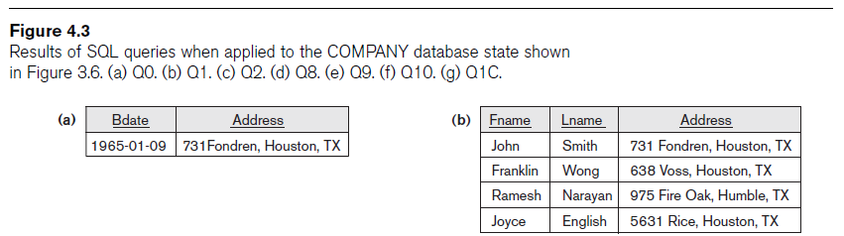



Slide 27




Slide 28

Ambiguous Attribute Names
Same name can be used for two (or more) attributes
  As long as the attributes are in different relations
  Must qualify the attribute name with the relation name to prevent ambiguity

Slide 29
Aliasing, Renaming, and Tuple Variables
Aliases or tuple variables
  Declare alternative relation names E and S
  EMPLOYEE AS E(Fn, Mi, Ln, Ssn, Bd, Addr, Sex, Sal, Sssn, Dno)

Slide 30

Unspecified WHERE Clause and Use of the Asterisk
Missing WHERE clause
  Indicates no condition on tuple selection
CROSS PRODUCT
  All possible tuple combinations

Slide 31

Unspecified WHERE Clause and Use of the Asterisk (cont’d.)
Specify an asterisk (*)
  Retrieve all the attribute values of the selected tuples

Slide 32

Tables as Sets in SQL
SQL does not automatically eliminate duplicate tuples in query results
Use the keyword DISTINCT in the SELECT clause
  Only distinct tuples should remain in the result

Slide 33

Tables as Sets in SQL (cont’d.)
Set operations
  UNION, EXCEPT (difference), INTERSECT
  Corresponding multiset operations: UNION ALL, EXCEPT ALL, INTERSECT ALL)
Notes:
Union all will not eliminate duplicate rows. Union will eliminate duplicate rows.

Slide 34
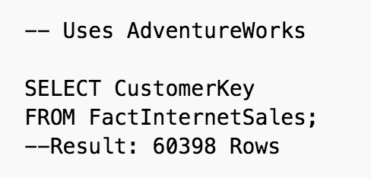
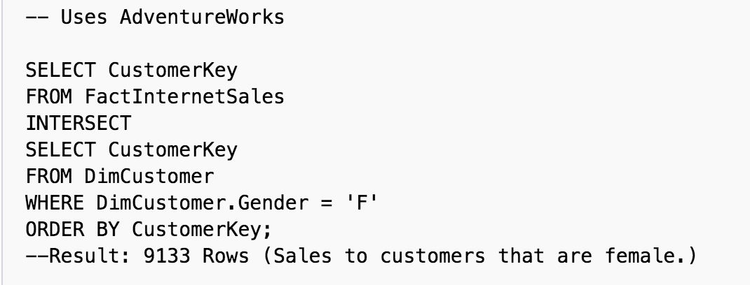
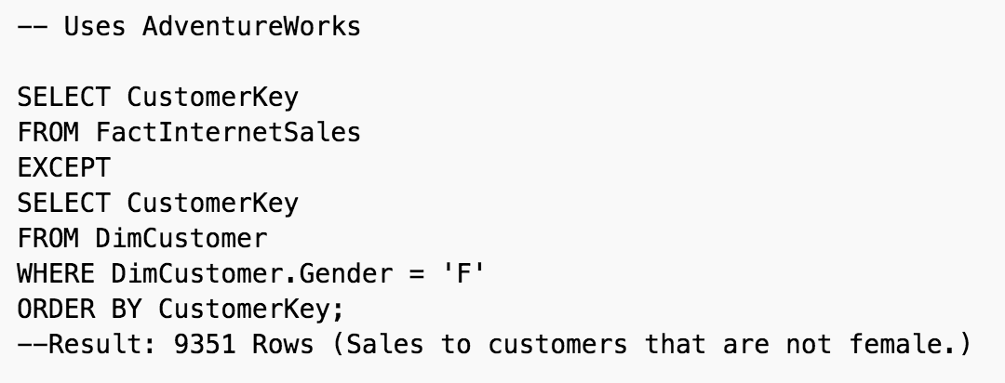
Distinct values that are returned by both the query on the left and right sides of the INTERSECT
operator.
Distinct values from the query to the left of the EXCEPT operator that are not also found on the right query.
Notes:
Union all will not eliminate duplicate rows. Union will eliminate duplicate rows.

Slide 35
Substring Pattern Matching and Arithmetic Operators
LIKE comparison operator
  Used for string pattern matching
  % replaces an arbitrary number of zero or more characters
  underscore (_) replaces a single character
Standard arithmetic operators:
  Addition (+), subtraction (–), multiplication (*), and division (/)
BETWEEN comparison operator

Slide 36
Ordering of Query Results
Use ORDER BY clause
  Keyword DESC to see result in a descending order of values
  Keyword ASC to specify ascending order explicitly
  ORDER BY D.Dname DESC, E.Lname ASC, E.Fname ASC

Slide 37

Discussion and Summary of Basic SQL Retrieval Queries

Slide 38
INSERT, DELETE, and UPDATE Statements in SQL
Three commands used to modify the database:
  INSERT, DELETE, and UPDATE

Slide 39


The INSERT Command
Specify the relation name and a list of values for the tuple

Slide 40

The DELETE Command
Removes tuples from a relation
  Includes a WHERE clause to select the tuples to be deleted

Slide 41

The UPDATE Command
Modify attribute values of one or more selected tuples
Additional SET clause in the UPDATE command
  Specifies attributes to be modified and new values

Slide 42
Additional Features of SQL
Techniques for specifying complex retrieval queries
Writing programs in various programming languages that include SQL statements
Set of commands for specifying physical database design parameters, file structures for relations, and access paths
Transaction control commands

Slide 43
Additional Features of SQL (cont’d.)
Specifying the granting and revoking of privileges to users
Constructs for creating triggers
Enhanced relational systems known as object-relational
New technologies such as XML and OLAP

Slide 44
Summary
SQL
  Comprehensive language
  Data definition, queries, updates, constraint specification, and view definition
Covered in Chapter 4:
  Data definition commands for creating tables
  Commands for constraint specification
  Simple retrieval queries
  Database update commands

